Slide 1
We will get started shortly.
International Science Nutrition Society – CURARE CAUSAM - ISNS 2023

Slide 2
ISNS CASE STUDy
With Dr. Norbert Ketskes on Senile Dementia
International Science Nutrition Society – CURARE CAUSAM - ISNS 2023

Slide 3
Medical Disclaimer
The information provided is for educational purposes and is not intended as medical advice, or a substitute for the medical advice of a physician or other qualified health care professional. This is for science and educational purposes only and cannot be used in any aspect for sales or marketing. You should not use this information for diagnosing a health or fitness problem or disease. You should always consult with a doctor or other health care professional for medical advice or information about diagnosis and treatment. This is Confidential. Do not distribute—for scientific educational purposes only.
International Science Nutrition Society – CURARE CAUSAM - ISNS 2023

Slide 5
DR. NORBERT KETSKÉS, MD
Dr. Norbert Ketskés M.D. is one the most acknowledged gastroenterologist in Hungary, specializing in natural and organic nutritional solutions, leading the well-known Primus Labor, a private clinic offering personalized nutritional advices to its patients.
Scientific Adviser of ISNS
Independent Scientific Adviser of Rain International in Europe since 2013
Medical Partner of the Hungarian Olympic Committee since 2015
Member of the Medical board of Hungarian Karate Association since 2015
Leader of the Primus Labor Private Medical Clinic since 2013
Working as a Family Doctor 1999 – 2012
International Science Nutrition Society – CURARE CAUSAM - ISNS 2023

Slide 6
CSISZTU ZSUZSA
Television - Presenter, Anchor, Editor, Journalist and Sports Lawyer, Sport-diplomat
Spokesperson of the Giro d’Italia Grande Partenza, (Road-Cycling World -Tour Championship)
Spokesperson of the FINA (Swimming and Waters poets World Championship)
2022 Vice-President of the Hungarian Sports Journalists’ Association
Member of the Hungarian Olympic Committee Member of the Advisory Board of the Hungarian Olympic Academy
Newly Elected Vice-President of the International Sports Journalists Association, the first female ever in the field from her homeland, and third globally since 1924 (AIPS)
International Science Nutrition Society – CURARE CAUSAM - ISNS 2023

Slide 7
Senile Dementia
Senile also known as Senile dementia is the mental deterioration (loss of intellectual ability) that is associated with or the characteristics of old age.
Two major types of senile dementia are identified as: those due to generalized “atrophy” (Alzheimer’s-type dementia) and those due to vascular problems (mainly, strokes).
Senile dementia is often used when referring to Alzheimer’s disease.
International Science Nutrition Society – CURARE CAUSAM - ISNS 2023

Slide 8
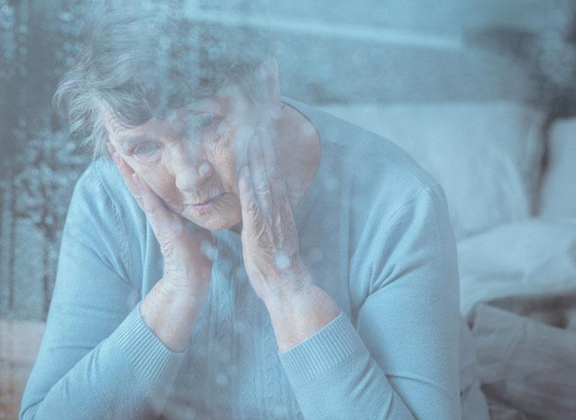
What is Senility?
Senility, which is now more commonly referred to as dementia, is characterized by a decrease in cognitive abilities or mental decline. This may include the person’s ability to concentrate, to recall information, and to properly judge a situation.
Senility is a deterioration of body and mind associated with advanced aging. Indications of old age vary in the time of their appearance.
International Science Nutrition Society – CURARE CAUSAM - ISNS 2023

Slide 9
What are the symptoms of Senility?
Senility symptoms are many of the physical changes associated with old age:
Stooped posture
Wrinkled skin
Decrease in muscle strength
Changes in lens and muscles of the eye
Brittleness of bone and stiffness of joints
Hardening of the arteries
There are also mental changes associated with senility:
Impaired judgement
Loss of memory
Sometimes childish behavior
The actual psychological changes are thought to be related to aging of the cortical brain cells. Whereas the physical changes associated with aging occur in all individuals to some extent, evidence of psychological degeneration in not universal. In common usage, the term senility is applied only to mental deterioration.
International Science Nutrition Society – CURARE CAUSAM - ISNS 2023

Slide 10
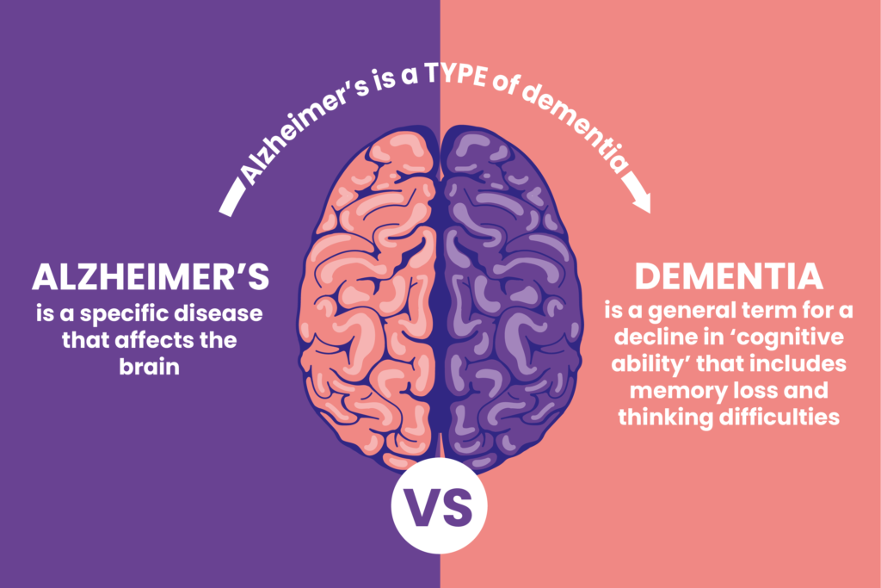
Dementia
Dementia is a term used to describe a group of symptoms affecting memory, thinking and social abilities severely enough to interfere with your daily life. It isn’t a specific disease, but several diseases can cause dementia.
Though dementia generally involves memory loss, memory loss has different causes. Having memory loss alone does not mean you have dementia, although it is often one of the early signs of the condition.
Alzheimer’s disease is the most common cause of progressive dementia in older adults, but there are a number of other causes of dementia. Depending on the cause, some dementia symptoms might be reversible.
International Science Nutrition Society – CURARE CAUSAM - ISNS 2023

Slide 11
Dementia Symptoms
Dementia symptoms vary depending on the cause, but common signs and symptoms include:
Cognitive Changes:
Memory loss, which is usually noticed by someone else
Difficulty communicating or finding words
Difficulty with visual and spatial abilities, such as getting lost while driving
Difficulty reasoning or problem-solving
Difficulty handling complex tasks
Difficulty with planning and organizing
Difficulty with coordination and motor functions
Confusion and disorientation
Psychological changes:
Personality changes
Depression
Anxiety
Inappropriate behavior
Paranoia
Agitation
Hallucinations
See a doctor if you or a loved one has memory problems or any of these other dementia symptoms. Some treatable medical conditions can cause dementia symptoms, so it is important to determine the cause
International Science Nutrition Society – CURARE CAUSAM - ISNS 2023

Slide 12
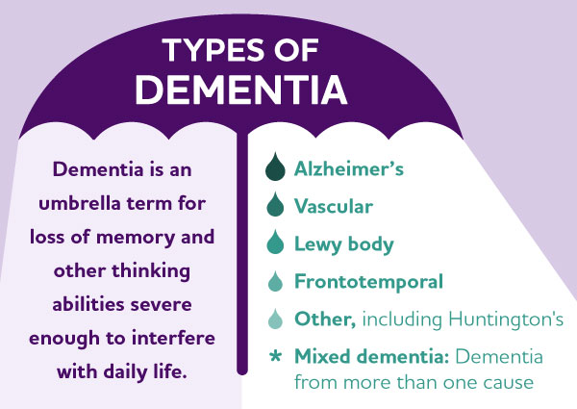
Types of Dementia
These types of dementias progress and are not reversible:
Alzheimer’s Disease – this is the most common cause of dementia. Alzheimer’s patients have plaques and tangles in their brains.
Vascular Dementia – this type of dementia is caused by damage to the vessels that supply blood to your brain.
Lewy Body Dementia – Lewy bodies are abnormal balloon like clumps of protein that have been found in the brains of people with Lewy body dementia, Alzheimer’s disease and Parkinson’s disease. This is of the more common types of progressive dementia.
Frontotemporal Dementia – this is a group of diseases characterized by the breakdown of nerve cells and their connections in the frontal and temporal lobes of the brain.
Mixed Dementia– having more than one type of dementia. Autopsies of the brains of people 80 and older who had dementia indicate that many had a combination of several causes, such as Alzheimer’s disease, vascular dementia, and Lewy body dementia.
International Science Nutrition Society – CURARE CAUSAM - ISNS 2023

Slide 13
Risk Factors for Dementia
Many factors can eventually contribute to dementia. Some factors, such as age, can’t be changed. Others can be addressed to reduce your risk.
Risk Factors that cannot be changed:
Age – the risk rises as you age, especially after age 65. However, dementia can occur in younger people.
Family history – having a family history of dementia puts you at a greater risk of developing the condition. However, many people with a family history never develop symptoms, and many people without a family history do. There are tests to determine whether you have certain genetic mutations.
Down syndrome – by middle age, many people with down syndrome develop early-onset Alzheimer’s disease.
You may be able to control the following risk factors for dementia.
Risk Factors that you can change:
Diet and exercise – research shows that lack of exercise increases the risk of dementia.
Excessive alcohol use – drinking large amounts of alcohol has long been known to cause brain changes.
Cardiovascular risk factors – these include high blood pressure (hypertension) high cholesterol, buildup of fats in your artery walls (atherosclerosis) and obesity.
Diabetes – having diabetes may increase your risk of dementia, especially if it is poorly controlled.
Sleep disturbances – people who have sleep apnea and other sleep disturbances might be at a higher risk of developing dementia.
International Science Nutrition Society – CURARE CAUSAM - ISNS 2023

Slide 14
CASE STUDY
Patient: Male
Age: 72 years old
History:
Alzheimer's disease was diagnosed 1 year ago
Medical history:
Lab tests:
TSH (hypothyroidism), B12 and folic acid levels, Creatinine and electrolytes (kidney disease), Liver function values- Normal range
Clinical test:
The Mini-Mental State Examination (MMSE) is a 30-point, quick-to-take cognitive test that is mainly used to identify dementia and assess its severity in medical, clinical psychologist and neuropsychological practice.The interval from 30 to 29 is considered normal, points 27-28 may indicate a mild neurocognitive disorder, for those from 26 to 20 we assume mild dementia, from 19 to 10 moderate, and from 9 below severe we are talking about dementia.
In his case the result: 19
International Science Nutrition Society – CURARE CAUSAM - ISNS 2023

Slide 15
Conventional Treatment
There is currently no cure for dementia. But there are medicines and other treatments that can help with dementia symptoms.
Most of the medicines available are used to treat Alzheimer’s disease as this is the most common form of dementia. They can help to temporarily reduce symptoms.
The main medications are:
Acetylcholinesterase inhibitors – these medicines prevent an enzyme from breaking down a substance called actylcholine in the brain, which helps nerve cells to comminicate with each other.
Memantine – This medicine (also known as Namenda) is given to people with moderate to severe Alzheimer’s disease, dementia with Lewy bodies and those with a combination of Alzheimer’s disease and vascular dementia.
In his case:
Donepezil: 10mg
International Science Nutrition Society – CURARE CAUSAM - ISNS 2023

Slide 16
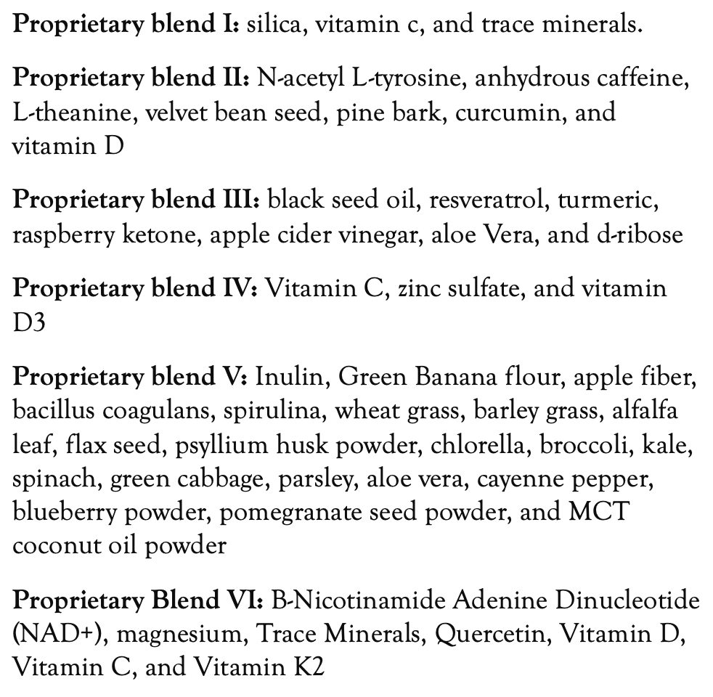
Method
PROPRIETARY BLENDS LEGEND
Proprietary blend I: 2x6 drops, morning and
evening, for 3 days, then every 3 days then
increased by 1-1 drops every 3 days to 2x12
Proprietary blend II :1 in the morning for 7 days, then 1 in the morning and 1 in the afternoon for 7 days, then 2 in the morning and 1 in the afternoon for 7 days, then 2 in the morning and 2 in the afternoon
Proprietary blend III: 1/2 sachet in the morning
for 7 days then 1 sachet in the morning
Proprietary blend IV: 1/2 teaspoon in the
morning for 7 days, then 1 teaspoon in the morning
Proprietary blend V: 1 teaspoon in the
in the evening
Proprietary blend VI: 1 in the
morning for 7 days then 1 in the morning and 1 in the evening for 7 days, then 2 in the morning and 1 in the evening
International Science Nutrition Society – CURARE CAUSAM - ISNS 2023

Slide 17
The ability to speak deteriorates, the ability to find information, the perception of time and the personality may also change.
There is currently no known traditional effective method for its treatment, but the quality of life can be improved.
A supportive family is indispensable, and in some cases even an expert nurse may be necessary!
International Science Nutrition Society – CURARE CAUSAM - ISNS 2023

Slide 18
Results
After 1 month :
The change was first reported by the family:
A slight improvement in speaking skills, the ability to find information, and the mood.
After 4 month:
Mini-Mental State Examination (MMSE): from 19 to 24!!!
Expressed improvement in speaking skills, ability to find information, perception of time and mood.
And not only the family, but also the patient could report on the improvement.
Based on these, the patient's quality of life improved!
In consultation with the neurologist, the dose of the drug was reduced from 10 mg to 5 mg.
International Science Nutrition Society – CURARE CAUSAM - ISNS 2023

Slide 19
Research Studies
International Science Nutrition Society – CURARE CAUSAM - ISNS 2023

Slide 20
Curcumin, Cardiometabolic Health and Dementia Yoona Kim and Peter Clifton
The aim of this review is to examine potential mechanisms of the actions of curcumin in both animal and human studies. Curcumin modulates relevant molecular target pathways to improve glucose and lipid metabolism, suppress inflammation, stimulate antioxidant enzymes, facilitate insulin signaling and reduce gut permeability. Curcumin also inhibits Aβ and tau accumulation in animal models and enhances mitochondria and synaptic function.
In conclusion, based on high-dose animal and in vitro studies, curcumin appears to be a promising therapeutic agent to decrease the risk of T2DM, CVD and neurodegenerative disease by improving glucose homeostasis, lipid metabolism, endothelial function and insulin signaling, and by inhibiting Aβ aggregation. These favorable effects of curcumin could be attributable to potent anti-oxidant and anti-inflammatory actions.
https://www.ncbi.nlm.nih.gov/pmc/articles/PMC6210685/
International Science Nutrition Society – CURARE CAUSAM - ISNS 2023

Slide 21
Role of Vitamin D in Cognitive Dysfunction: New Molecular Concepts and Discrepancies between Animal and Human Findings Zsolt Gall and Orsoyla Szekely
Increasing evidence suggests that besides the several metabolic, endocrine, and immune functions of 1alpha,25-dihydroxyvitamin D (1,25(OH)2D), the neuronal effects of 1,25(OH)2D should also be considered an essential contributor to the development of cognition in the early years and its maintenance in aging.
The neuroprotective, anti-inflammatory and antioxidant properties of vitamin D have been widely studied in preclinical studies, which then led to the hypothesis that vitamin D could serve as a potentially modifiable risk factor for cognitive decline and neurodegenerative diseases.
The evidence reviewed above demonstrates that vitamin D is important for normal brain development and function in rodents and humans, as deficiency can affect cognition.
https://pubmed.ncbi.nlm.nih.gov/34835929/
International Science Nutrition Society – CURARE CAUSAM - ISNS 2023

Slide 22
Zinc, and Neurodegenerative Diseases Masahiro Kawahara, Ken-Ichiro Tanaka, and Midori Kato-Negishi
Zinc (Zn) is abundantly present in the brain and accumulates in the synaptic vesicles. Synaptic Zn is released with neuronal excitation and plays essential roles in learning and memory. Increasing evidence suggests that the disruption of Zn homeostasis is involved in various neurodegenerative diseases including Alzheimer’s disease, a vascular type of dementia, and prion diseases.
Zn plays critical roles in the pathogenesis of neurodegenerative diseases, such as AD, VD, and prion diseases
https://www.ncbi.nlm.nih.gov/pmc/articles/PMC5852723/
International Science Nutrition Society – CURARE CAUSAM - ISNS 2023

Slide 23
References
https://www.alzinfo.org/articles/senile-dementia/
https://www.nia.nih.gov/health/infographics/understanding-different-types-dementia
https://www.ncbi.nlm.nih.gov/pmc/articles/PMC6210685/
https://pubmed.ncbi.nlm.nih.gov/34835929/
https://www.ncbi.nlm.nih.gov/pmc/articles/PMC5852723/
International Science Nutrition Society – CURARE CAUSAM - ISNS 2023

Slide 24
Thank You for Joining Us This Week!!
International Science Nutrition Society – CURARE CAUSAM - ISNS 2023

